Slide 1
SEP
User Research
(Enquiries portal prototype testing)
June 2020
Anubhav Mittal
David Graham

Slide 2
Who we tested with
A short survey was issued to the new partners at first to understand the current process, SLAs etc
(the responses to which are saved here)
This was followed by Skype moderated test sessions, with 4 new partners, to perform usability testing
Date conducted – 17th June and 23rd June 2020

Slide 3
What we were trying to find out
New partners to FBS website were shown the following enquiries portal prototype:
https://xd.adobe.com/view/e995937f-b2b9-48e3-7833-eb39ba773fc9-9fa4/?fullscreen&hints=on
General look and feel
Likes and dislikes
If anything was missing
If this enquiry management process will work for them
If there were any suggestions to improve this process

Slide 4
Summary
All 4 partners found the prototype to be simple and straightforward
Looks simple to use
Looks very straight-forward
It looks nice and simple, I would make sure to keep it that way. No need to complicate it
Partners would like some sort of notification when a new enquiry is received, this could be via a simple email to their inbox
The open enquiry page was easy to understand and partners were happy to see the search and sort options. One of them felt that having an enquiry type option would help them better understand multiple requests from a company.
The Actions button at the top was confusing to all, two felt that it was an action to fulfil an enquiry. But having clicked on the button to see “export as csv” was a good to have option.
The enquiry detail screen was also simple and easy to understand and it was comprehensive.
All felt that some sort of notes section while fulfilling the enquiry will be a useful thing to have as then they could see what has happened with the enquiry and who dealt with it.
All partners were of the opinion that it would be really useful if they could fulfil the enquiry from within the system otherwise their current processes are sufficient and having an enquiry portal is pointless.
If an enquiry was wrongly assigned to an org, they would like to send it back to the FBS central team back from within the portal by having a “send back to sender” option or something similar

Slide 5
FBS Enquiries Portal – Partner current processes
At present partners receive their enquiries via an email in their inbox.
The 4 partners receive very few enquiries every month
Usually there is more than one person looking and fulfilling enquiries
Response is via an email in most cases and sometimes via phone
Fulfillment happens via their email box and a record of this is kept in their mailbox for future reference
SLAs tend to vary between 24 hours to 48 hours

Slide 6
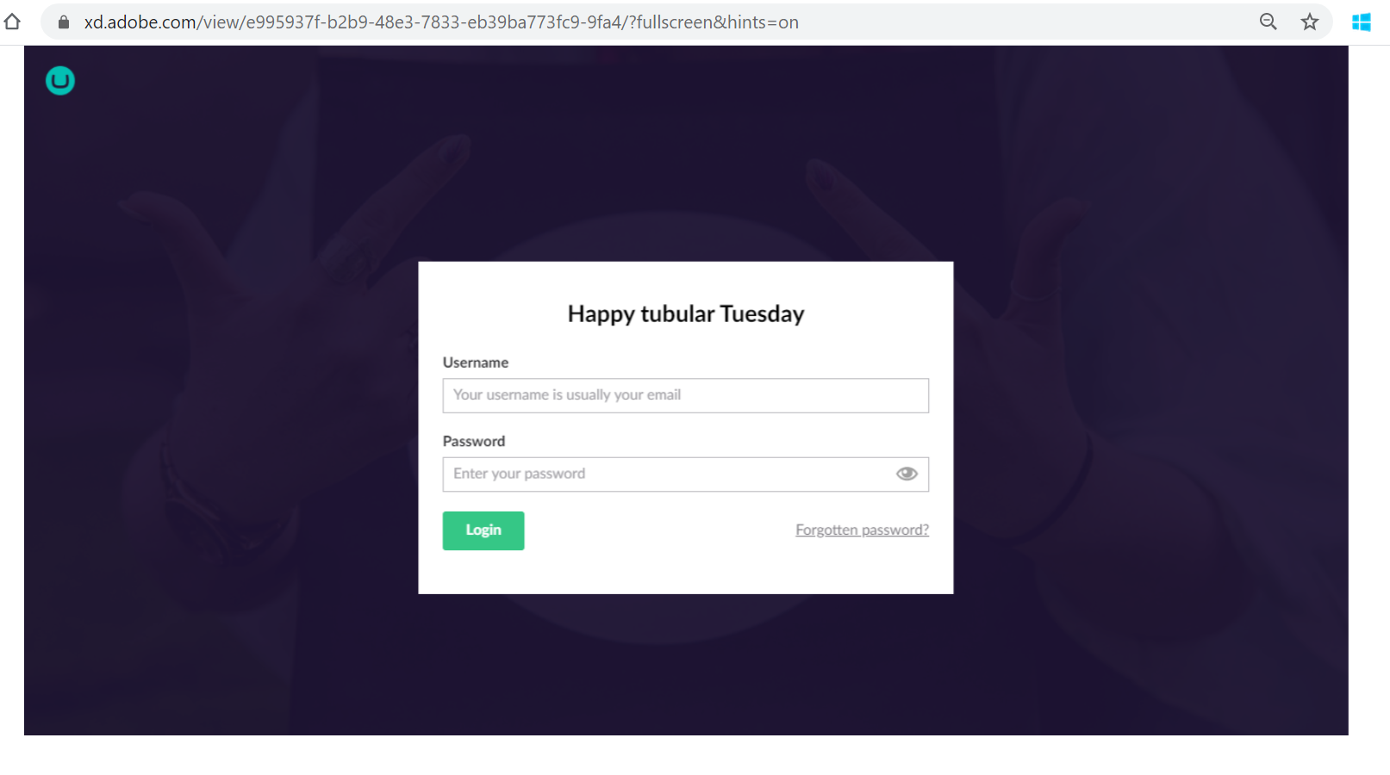
FBS Enquiries Portal Prototype
FBS Enquiries Portal Prototype
Looks simple and straightforward
“It will good if more than one can get login details to cover holidays etc”
“Can we change the logo?”
“I like the message”
“It will be good to get an email notification when a new enquiry comes to this portal”

Slide 7
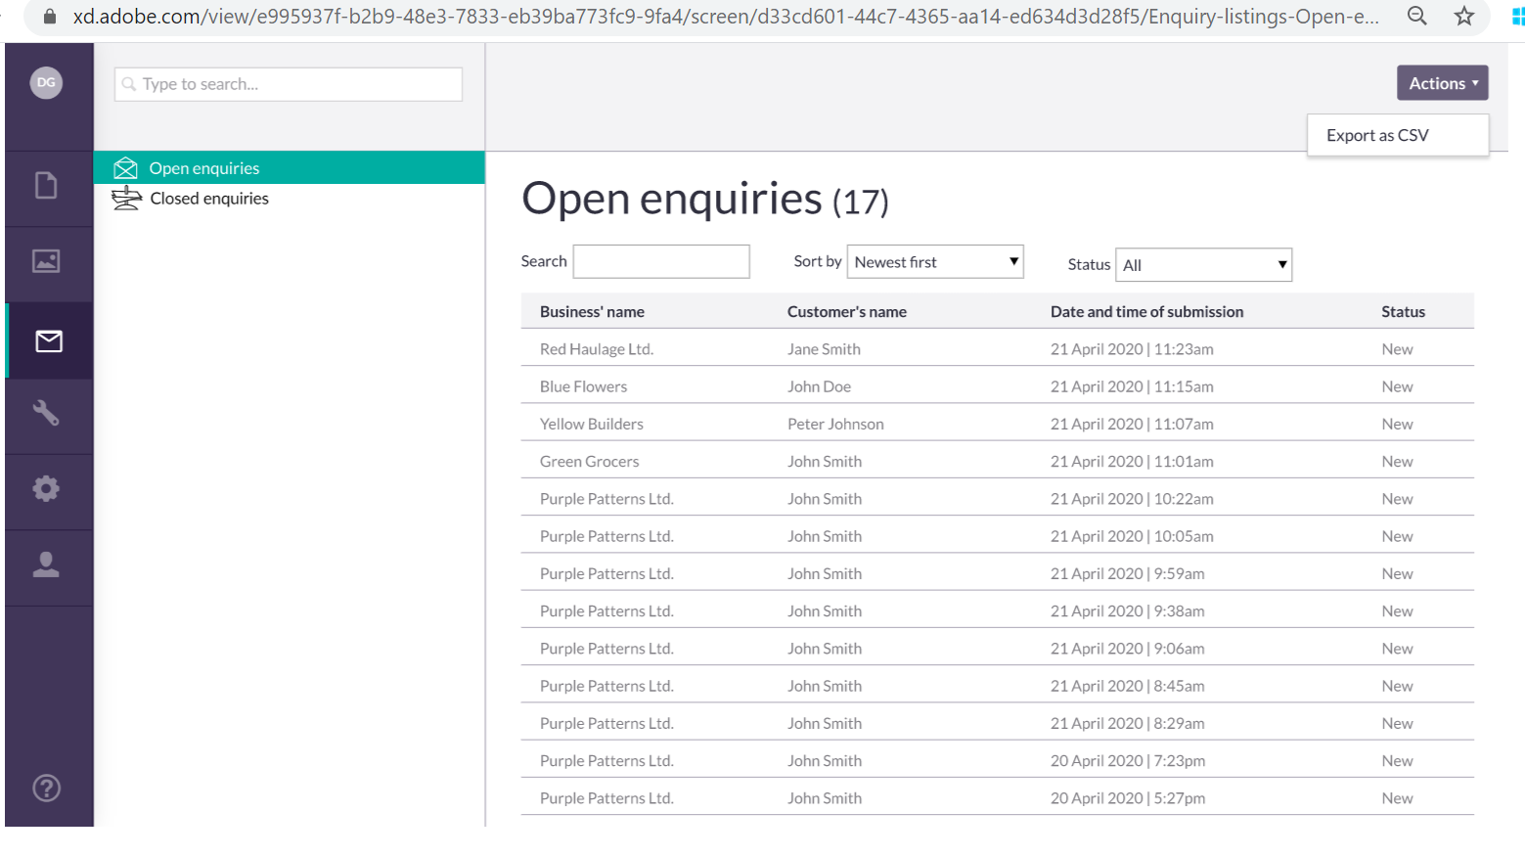
FBS Enquiries Portal Prototype
FBS Enquiries Portal Prototype
On ‘actions’ > ‘export as CSV’ – I guess it could be handy for reporting purposes, or if you wanted to clear some enquiries out of here to save you having a big long list
I probably wouldn’t export the individual enquiries into a spreadsheet
If I couldn’t re-route an enquiry in here that’s wrongly come to me I would try and find the right person in SE to email the enquiry details to (sounds like this uncertainty over what to do with these would potentially lead to enquiries getting lost)
I’d like a way to categorise the enquiries by topic
I would like enquiry management and fulfilment in one place, that would be best for us
If portal didn’t allow to fulfil, would like to get an email alert every time a new enquiry has arrived in portal
Would like to be able to fulfil the enquiry from within the portal rather than having to login and then use email to respond
“I would expect to be able to click ‘actions’ and be able to reply then and there. If I could do that, that would be perfect.”

Slide 8
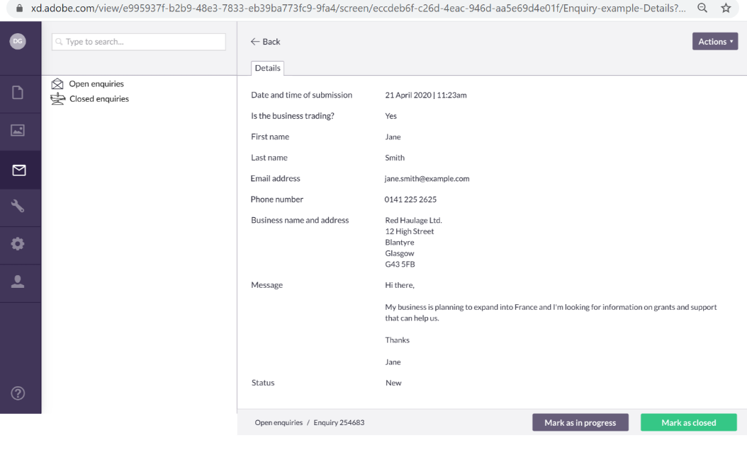
FBS Enquiries Portal Prototype
FBS Enquiries Portal Prototype
If I was able to reply back to enquiries from within this system, then that would be useful but if not, I would just have to copy and paste like we do on social media
I can’t see it being a massive issue having to copy and paste
“If I got an enquiry that wasn’t for me, how would I forward that on, and who would I send it to?”
“If I’m not able to email back from here and also can’t re-assign an enquiry that has wrongly come to me, how is that helping me?”
“Can we see who answered it, what they said and when it was closed? I’d want to see all of those.”
“I’d want to add notes, so I know what’s been done because, when you’re busy and you have to come back to something, you usually think, ‘what have I done with this again?’”
Wants to be able to add notes to enquiries so that everyone in the team can deal with on-going enquiries and have up to date information on what’s happening with the enquiry. Also helps the person who dealt with it the first time to remember when another enquiry is received later or when a response from elsewhere in their organisation is received back to pass onto the customer.
If the portal only shows the enquiries and I have to fulfil elsewhere, then it’s “highly likely” my team wouldn’t bother keeping status of enquiries up to date within the portal. FBS reporting of enquiry fulfilment will be difficult then)

Slide 9
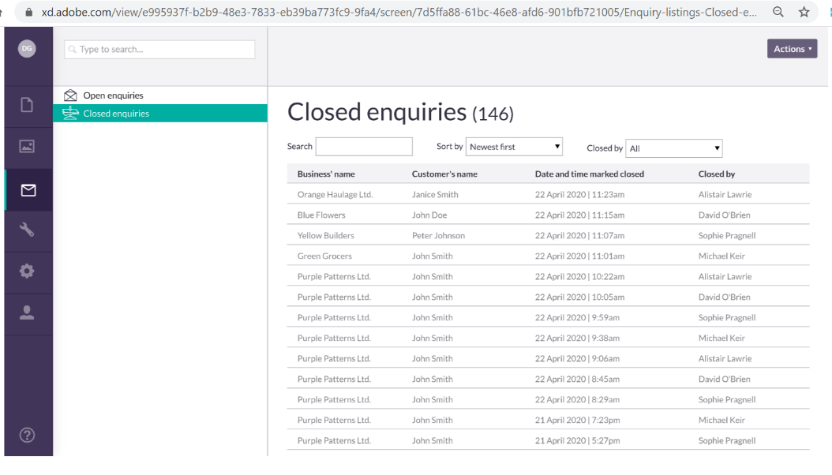
FBS Enquiries Portal Prototype
FBS Enquiries Portal Prototype
“It’s simple and easy to understand, I can also search and sort which is good”
One export as CSV under actions button – maybe you would want to export for reporting or something like that – can be helpful
One partner was worried about losing track of a series of enquiries that are related because, different people form the team each responding numerous times. Currently there is no way to tag or group enquiries to show they are part of a conversation

Slide 10
Thank you!

